Slide 1
Java
Testing

Slide 2
Unit Test
Unit Testing is a level of software testing where individual units/ components of a software are tested
A unit is the smallest testable part of any software
It usually has one or a few inputs and usually a single output.

Slide 3
Add Junit dependency
<dependency>
<groupId>org.junit.jupiter</groupId>
<artifactId>junit-jupiter</artifactId>
<version>5.7.0</version>
<scope>test</scope>
</dependency>

Slide 4
Testing
All tests must be in test folder
When writing tests you can use all classes from main folder
By default configuration files from main folder will be used
You can add configuration files with same name to overwrite them for test profile

Slide 5
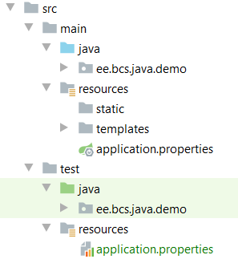
Testing
Tests have their own file structure

Slide 6
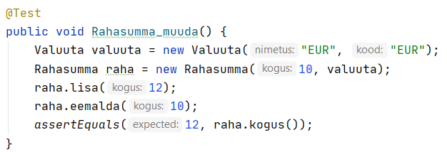
Testi kirjutamine

